Slide 1
AGENDA
ANALYSIS
RECOMMENDATION
IMPLEMENTATION
IMPACT
Elizabeth Benyamin | Ekin Njotoatmodjo | Michael Orlando | Abrevaa E. Prihutama | Britney Sugiarto
MGMT 430 F Sp 22 - Strategy Development Case Competition

Slide 2
AGENDA
ANALYSIS
RECOMMENDATION
IMPLEMENTATION
IMPACT
Agenda
RECOMMENDATION
IMPLEMENTATION
ANALYSIS
IMPACT

Slide 3
AGENDA
ANALYSIS
RECOMMENDATION
IMPLEMENTATION
IMPACT
Business & Industry Conditions
First US wireless firm to roll out nationwide 5G coverage.
Disruptor
Intangible service, lack of durability
“Uncarrier”
Capital intensive industry with low variable costs
Demand preferences shaped by internet quality. High switching costs for carrier, but high price elasticity.
Extended Range 5G, covers 310 million Americans, 94% of U.S. population
Porter’s Analysis
PESTLE
Triangle Model

Slide 4
AGENDA
ANALYSIS
RECOMMENDATION
IMPLEMENTATION
IMPACT
SWOT
Strengths
Weaknesses
S
W
First mover advantage in 5G internet coverage. Strong network infrastructure with quality services. 94% coverage in the United States
Relatively low market shares in the B2B segment. Lack of sustainable differentiation. Low contribution margin.
Opportunities
O
T
Threats
Proliferation of startups and SMBs in the United States. Momentum in e-commerce.
Strong, concentrated competitions. Customers attrition. Complex and changing regulations.

Slide 5
AGENDA
ANALYSIS
RECOMMENDATION
IMPLEMENTATION
IMPACT
Competitive Position
Value Offerings
Market Share

Slide 6
AGENDA
ANALYSIS
RECOMMENDATION
IMPLEMENTATION
IMPACT
T-Mobile’s Current Challenges
5%
others
10%
35%
50%
Market Share: Wireless Services for Businesses

Slide 7
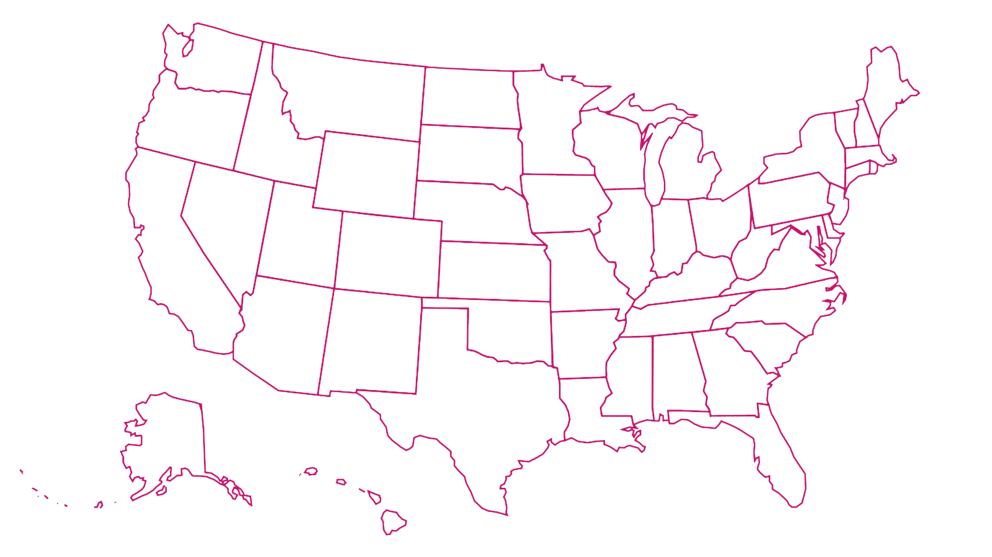
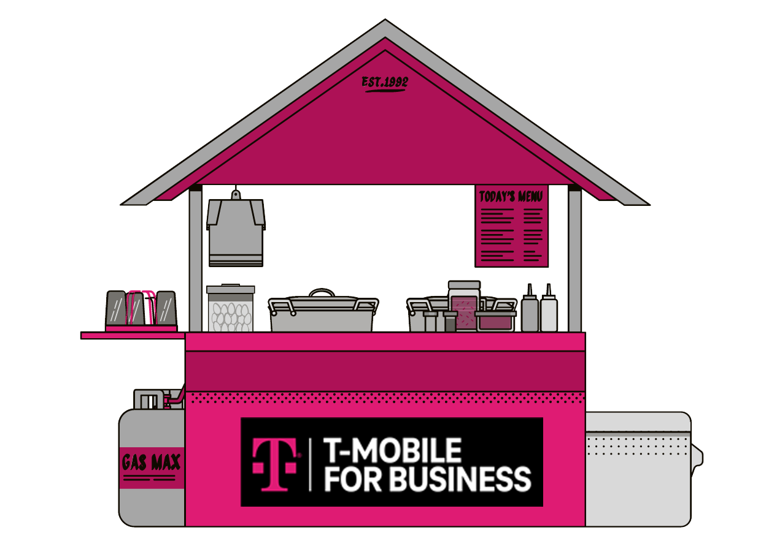
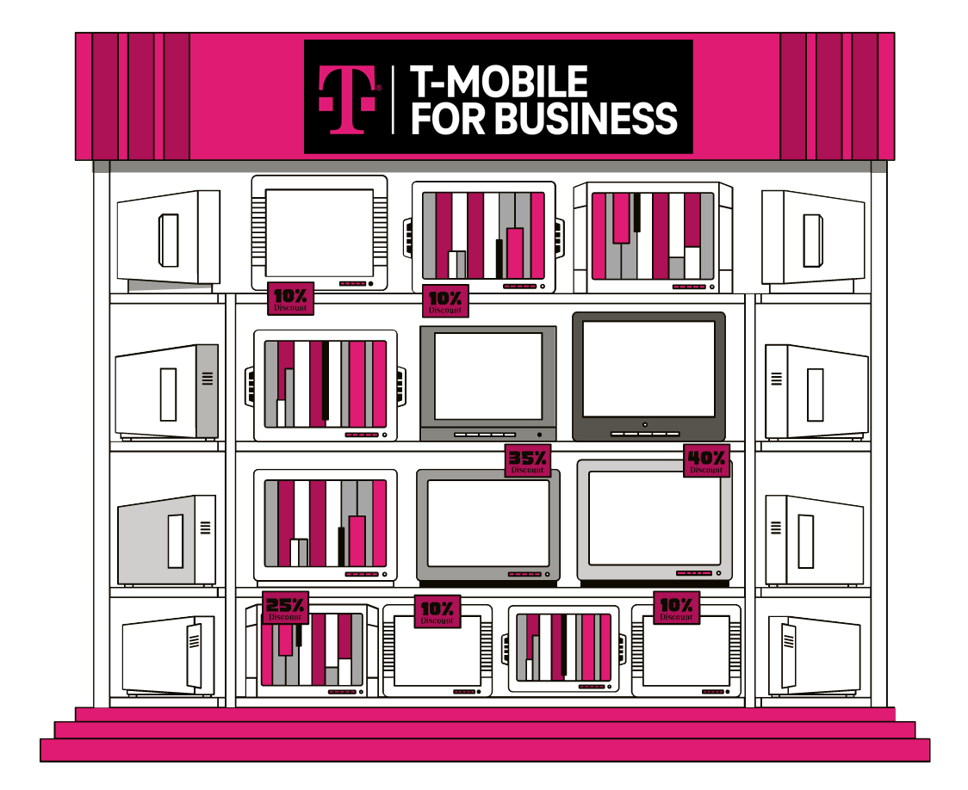
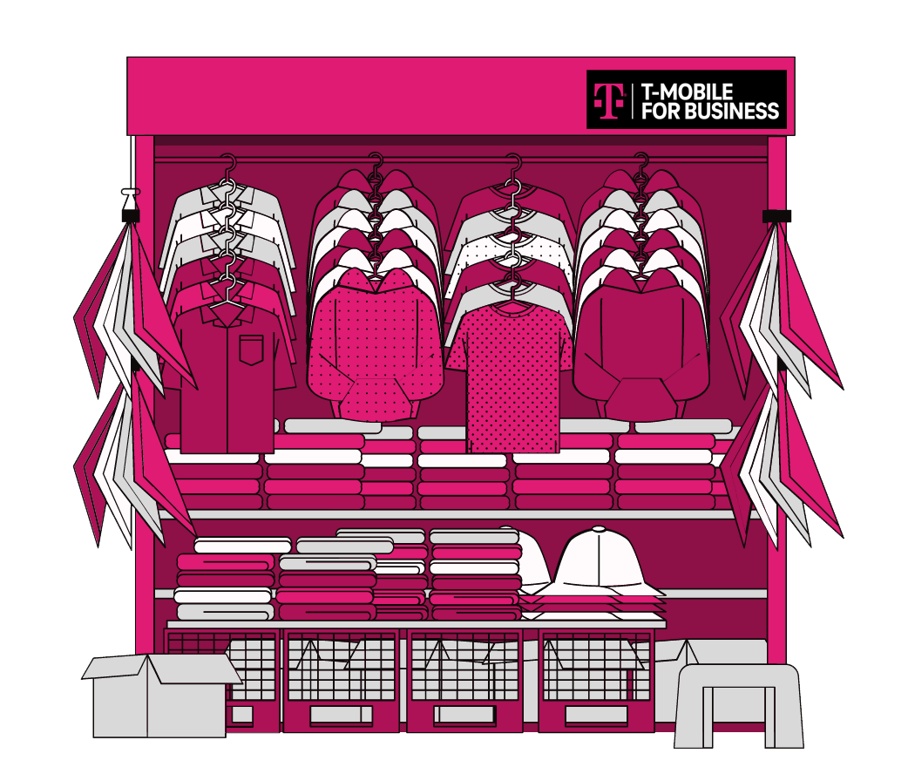
AGENDA
ANALYSIS
RECOMMENDATION
IMPLEMENTATION
IMPACT
Customer Segment
5G initiative to
EMPOWER and DIGITALIZE
across United States
Hitting a record
high in 2021
Tech Difficulty and high cost
Up to 80% do manual integration
+50% want to spend more on business tech
Overcommitment

Slide 8
5G for $5
per line
AGENDA
ANALYSIS
RECOMMENDATION
IMPLEMENTATION
IMPACT
Recommendation
Smarter
Easier
Cheaper

Slide 9
5G for $5
AGENDA
ANALYSIS
RECOMMENDATION
IMPLEMENTATION
IMPACT
Tactics
Bundled Business Management Features
Lowest-Price 5G Internet Package in the U.S.
Platform
Onboarding Service
A platform that combines POS and internal communications to power small business startups.
Access to unlimited 5G internet for only $5 per business device.
Boost operations excellence by digitalization guided by continued assistance from our trusted tech advisors.
powered by:

Slide 10
PINK
AGENDA
ANALYSIS
RECOMMENDATION
IMPLEMENTATION
IMPACT
Bundled Business Management
Mix and Match Unified Communications
Pay per Features

Slide 11
PINK
AGENDA
ANALYSIS
RECOMMENDATION
IMPLEMENTATION
IMPACT
Bundled Business Management
Payment
Business Communication
Invoicing
Meeting Conferencing
Client Engagement
Tracking and Reporting
Contact Center Creation
Mix and Match Unified Communications
Pay per Features
Inventory Management
Sales Dialer
Employee Management

Slide 12
PINK
AGENDA
ANALYSIS
RECOMMENDATION
IMPLEMENTATION
IMPACT
Bundled Business Management
Payment
Business Communication
Invoicing
+
Meeting Conferencing
Client Engagement
$10/mo each
$13/user
/mo each
Tracking and Reporting
Contact Center Creation
Mix and Match Unified Communications
Pay per Features
Inventory Management
Sales Dialer
Employee Management

Slide 13
AGENDA
ANALYSIS
RECOMMENDATION
IMPLEMENTATION
IMPACT
Internet Package
Unlimited 5G and 4G LTE data on our network
5G for $5 per line
Basic Plan that is Cost Efficient
Unlimited talk and text

Slide 14
AGENDA
ANALYSIS
RECOMMENDATION
IMPLEMENTATION
IMPACT
Pricing
5G for $5
Add!
$45 Feature Subscription Minimum
Add!
5G for $5
Add!
5G for $5
Add!
5G for $5

Slide 15
AGENDA
ANALYSIS
RECOMMENDATION
IMPLEMENTATION
IMPACT
Onboarding Service
App format
15 minutes
Content Marketing
24/7 tech support
Online Course
24/7

Slide 16
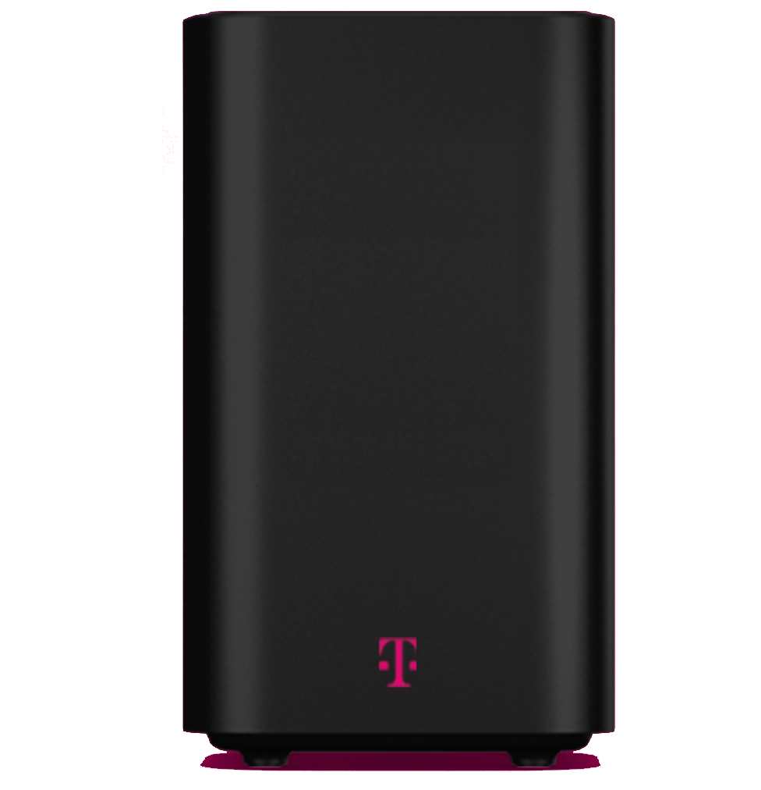
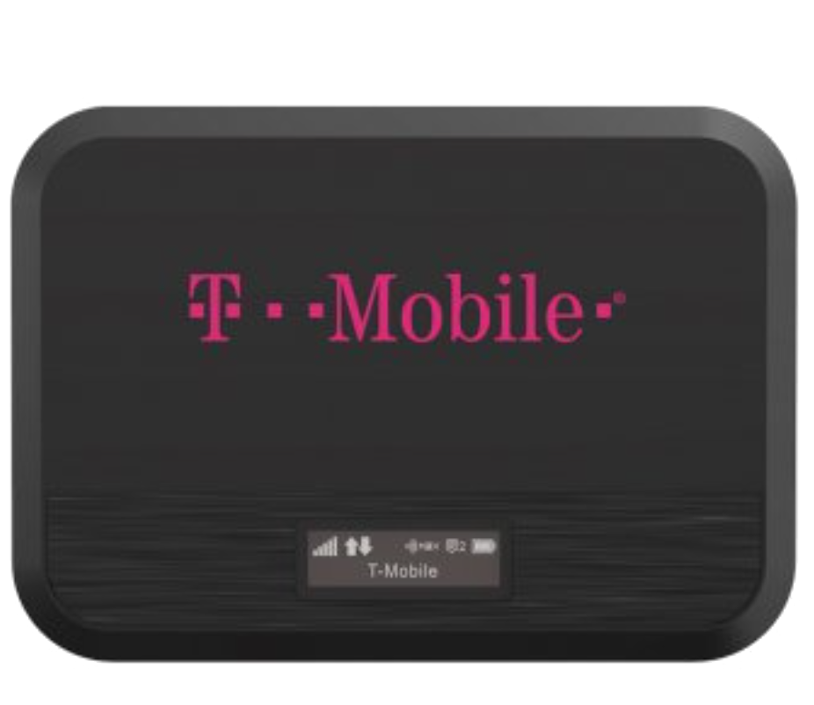
AGENDA
ANALYSIS
RECOMMENDATION
IMPLEMENTATION
IMPACT
Alternatives: Internet Package
Portable Modem
$336
Difficult to regulate
Individuals may move around, not teams.
Router
Hardware costs
Additional fees (installation, maintenance, etc.)
Click to see alternative matrix!

Slide 17
AGENDA
ANALYSIS
RECOMMENDATION
IMPLEMENTATION
IMPACT
Resources and Capabilities
Resources
Capabilities
Effective Negotiation
Legal
Portfolio Management
IT Project Management
Technology Management
Campaign & Marketing Management
Sales Planning, Forecasting, Management
Customer Management
Customer Care
Data Science
Human Capital - Engineering & Marketing Expertise, Customer Care
R&D
Internal System
Time

Slide 18
AGENDA
ANALYSIS
RECOMMENDATION
IMPLEMENTATION
IMPACT
Implementation Timeline
2022
2023
2024
2025
2026
2027
Jan
Jun
Dec
Jan
Jun
Dec
Jan
Jun
Dec
Jan
Jun
Dec
Jan
Jun
Dec
Jan
Jun
Dec
Market Research
Application and Software Development
Beta Version & Testing
Product Launching
Marketing Campaign
POS Onboarding Services
Software Update & Maintenance

Slide 19
AGENDA
ANALYSIS
RECOMMENDATION
IMPLEMENTATION
IMPACT
GTM Campaign
Email Marketing
SEO on Landing Pages
Social Media Marketing
(Instagram & Twitter)
Retargeting Ads
TV Ads
Print Ads - Billboard

Slide 20
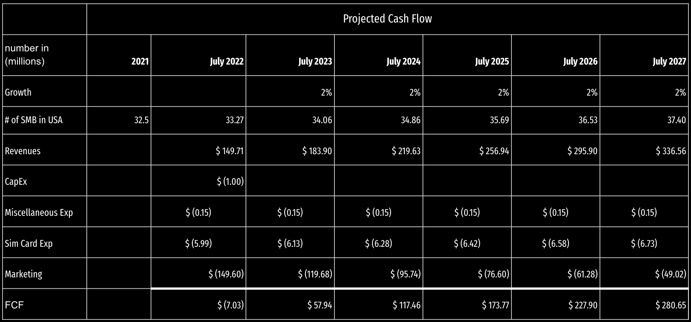
AGENDA
ANALYSIS
RECOMMENDATION
IMPLEMENTATION
IMPACT
Financial Analysis - Net Present Value
Practical Considerations:
No. SMBs in USA : 32.5 M
Discount Rate : 5.10%
Market Penetration : 60%
SMB Market Share : 10%
Subscription Min : $45
Internet plan : $5
Baseline Ave #User : 6/biz
Sim Card Mfg Cost : $0.5
Click to View
Sensitivity Analysis
Project NPV = $ 675.32 M

Slide 21
AGENDA
ANALYSIS
RECOMMENDATION
IMPLEMENTATION
IMPACT
Financial Analysis - Net Present Value
NPV before Profit Sharing: $675.32M
In Millions (M)
PROFIT SHARING | 70% | 15% | 15%
Final NPV | $472.72 | $101.30 | $101.30
NPV for T-Mobile After Profit Sharing: $472.72M
Click to View Sensitivity Analysis

Slide 22
AGENDA
ANALYSIS
RECOMMENDATION
IMPLEMENTATION
IMPACT
Risks and Mitigations
Business User Verification
Customer’s Data Security
Requiring customers to provide name, address, logo, industry, and SSN
Creating foolproof information system infrastructure in the beginning.

Slide 23
AGENDA
ANALYSIS
RECOMMENDATION
IMPLEMENTATION
IMPACT
Community Impact
#1
Customer (SMB)
Streamlined business processes
Efficient operations management
Technological introduction
#2
Business (T-Mobile)
Increase in market share
Add value to customer and community
Add business portfolio
#3
Partner (Clover)
70:15:15 Profit sharing from PinkClover partnership.
Penetration to untouched market
#4
Employee
Increase employees’ inclination to work at T-Mobile
Improve business performance
#5
Community
Higher Economic Productivity
Nurturing Entrepreneurship

Slide 24
Double Market Share
Volume of PINK Subscribers
Retention of PINK Subscribers
AGENDA
ANALYSIS
RECOMMENDATION
IMPLEMENTATION
IMPACT
Key Performance Indicator
By 2027
4.4 million of Small Business Startups in the United States by 2027
Min. 75% Monthly Retention Rate

Slide 26
appendix
AGENDA
ANALYSIS
RECOMMENDATION
IMPLEMENTATION
IMPACT

Slide 27
APPENDIX
Table of Contents
PORTER
DIALPAD Current
Small Medium Business Data
Retention Rate
PESTLE
Sensitivity Analysis I
Discount Rate
Customer Segment
TRIANGLE MODEL
Sensitivity Analysis II
Target v. Penetration
SIM Card Mfg. Cost
T-MOBILE Current
Financial Considerations
Target Market Justification
Implementation Phase
CLOVER Current
5G Service Alternatives
Onboarding Mechanism
Competitive Positioning

Slide 28
APPENDIX
Porter’s Five Forces + Complements
Rivalry
Extreme competition characterized with few prominent player but aggressively bidding for market shares through service activations.
Buyer’s Power
Moderate buyer power. Demand preferences shaped by internet quality. High switching costs for carrier, but high price elasticity. Prone to cheaper offerings.
Supplier’s Power
Infrastructure vendors holds high supplier power due to the state-of-art technicalities and engineering. Risk of shifting business and leak company secret to competitors.
Substitutes
High substitute level because various choices of carriers are available to select from.
Threats of New Entry
Massive capital requirements and presence of industries with established economies of scale and scope has built high barriers of entry.
Complements
Partnerships with tech companies such as Apple and Samsung to create functional bundled offerings of devices and services.

Slide 29
APPENDIX
Pestle Analysis
POLITICAL
ECONOMIC
SOCIAL
SMB Regulatory Frameworks
Corruption Perception Index
Ease of Doing Business
Currency fluctuations
Rising business costs
Action-Reaction from Competitor
Targeting the SMB market
Low contribution margin for SMB Entrepreneur
Trend of setting online businesses
TECHNOLOGICAL
ENVIRONMENTAL
LEGAL
Digital Business Management System
Availability of Onboarding Services
Reduction carbon footprint
Sustainable business practices
Ethical business practices
Intellectual Property
Regulatory Frameworks
Data and Cybersecurity

Slide 30
APPENDIX
Triangle Model
Where/What
Internet Plans,
Smart Devices, IoT Solutions
Coverage in 210+ Countries
Consumer & Business Customers
Physical Stores, Online Customer Service,
Older phones will stop working with TMob,
4G Coverage Gap
Award winning career development, reduce carbon footprint, employed TRPM process
Tradeoff
Fit
How
When
Revenue: Service &
Equipment
Strategy: Low Price
Who
Market Disruptor,
Frequently First Mover
Provides the Fastest 5G Speed
& Greatest Average 5G Availability
Customers, Employees,
Communities, Shareholders,
Suppliers, Manufacturers,
Business Partners (Sprint)
Uniqueness
Back to Analysis
Largest & fastest 5G network

Slide 31
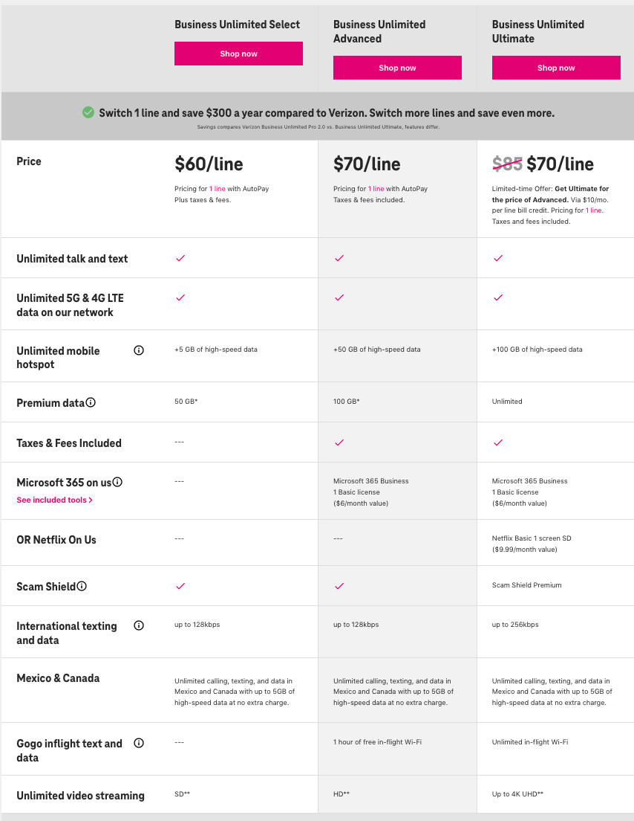
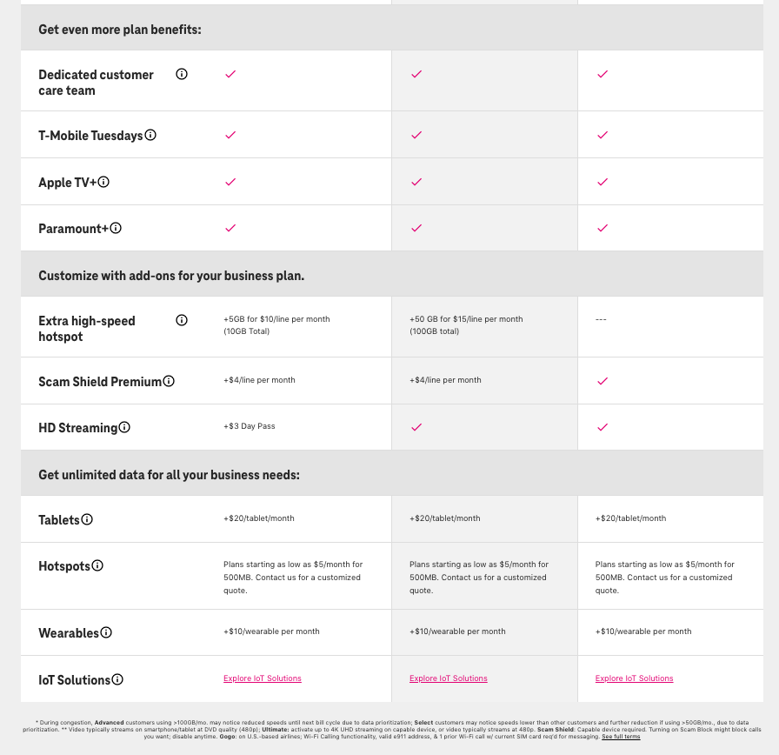
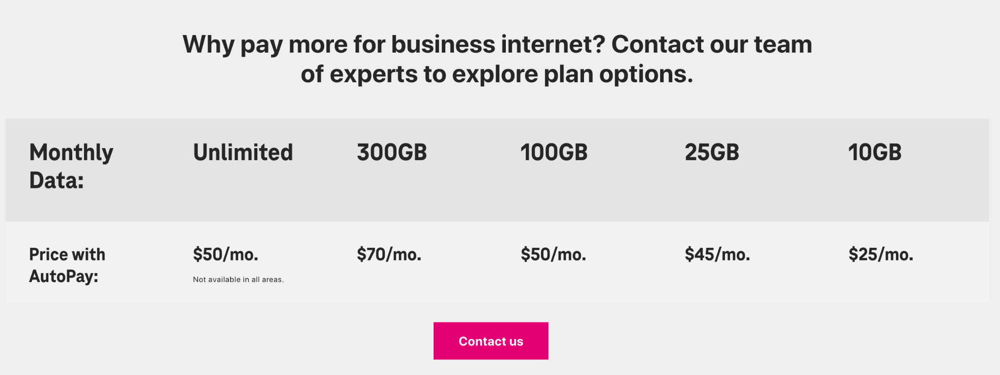
APPENDIX
T-Mobile for Business Current Offerings
Source: (T-Mobile, “Business Unlimited Pricing”, 2022)
https://www.t-mobile.com/support/account/account-hub-index

Slide 32
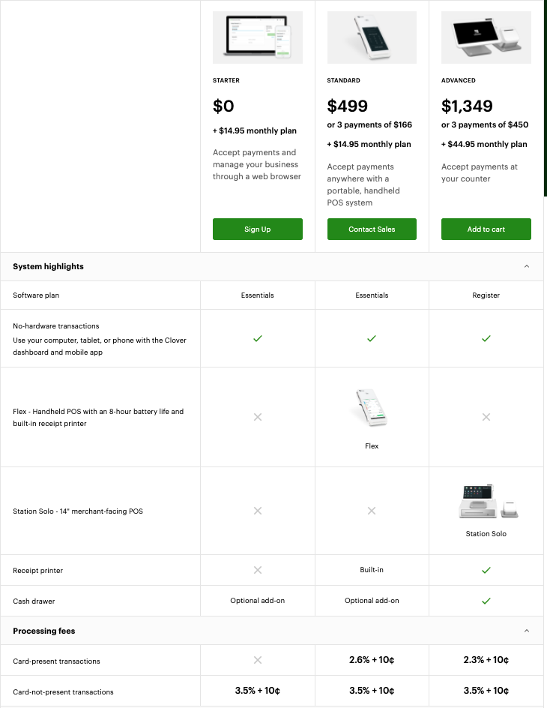
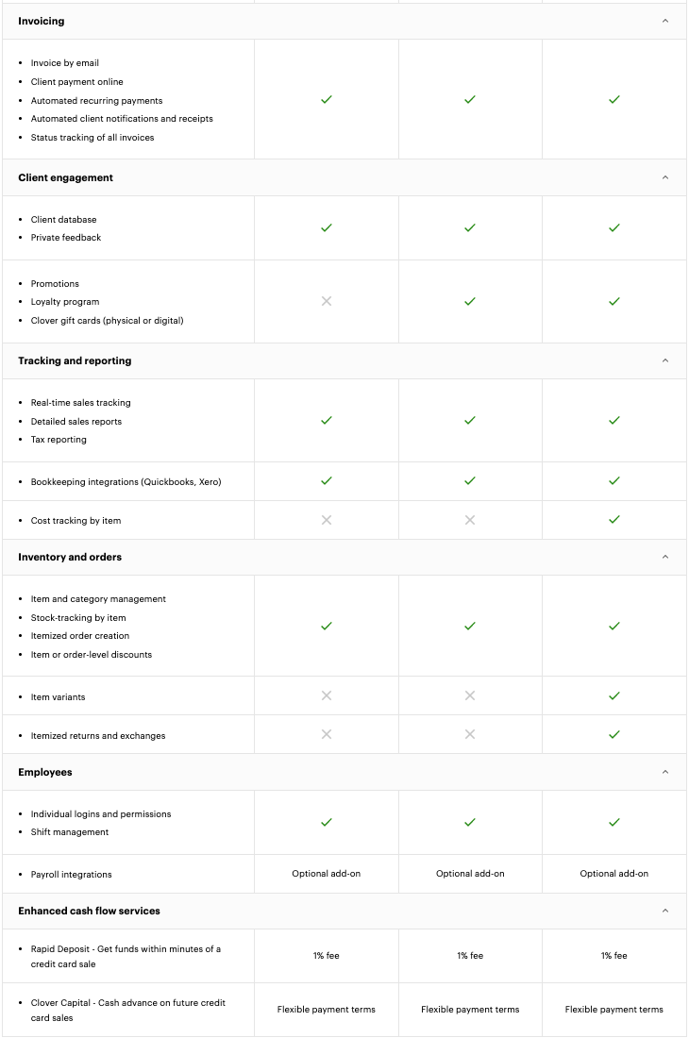
APPENDIX
Clover Current Offerings
Source: (Clover, “Professional Service Business System”, 2022)
https://www.clover.com/pricing/professional-services

Slide 33
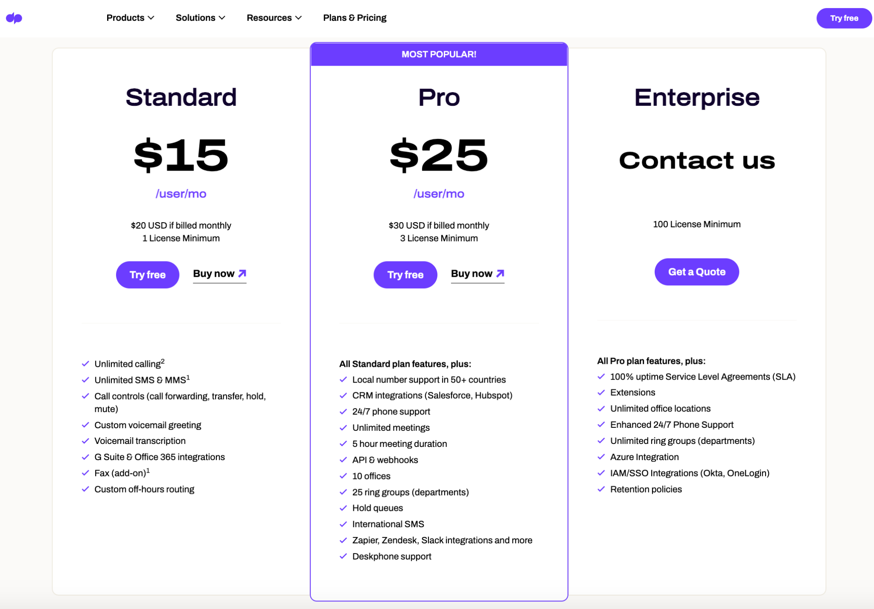
APPENDIX
Dialpad Current Offerings
Source: (Dialpad, “Pricing”, 2022)
https://www.dialpad.com/pricing/

Slide 34
APPENDIX
Alternatives of 5G Service
Portable Modem | Sim Card | Router
$5 per device connected to Modem | $5 per line for unlimited access to 5G services. | $5 per device registered to the Router service
Mobility and Portability for moving around. Unlimited usage for any electronic devices. Serve range of areas. | Mobility and Portability for moving around | Available to use within range of areas (home office, study room, etc).
Difficult to regulate number of connections | Limited usage to tablet and smartphones | Not portable. Risk of usage exploitation. High capital investment and installation costs
Back to Alternative Slide

Slide 35
APPENDIX
Mechanism of Onboarding Service
1. An asynchronous online course
mobile app/website format
broken down into 15 minute sessions
Mix of videos, interactive elements, hands on tutorial/practice
Basic usage of the app, but also the capabilities and benefits of each feature
Content marketing and providing information and resources beneficial to our target users
2. 24/7 Tech support is also available = intended to provide continued help throughout the online course and especially after the onboarding process.

Slide 36
APPENDIX
Customer Segment Data
NPR Statistics: New businesses soared to record highs in 2021. Here's a taste of one of them
Small Business Technology Spending

Slide 37
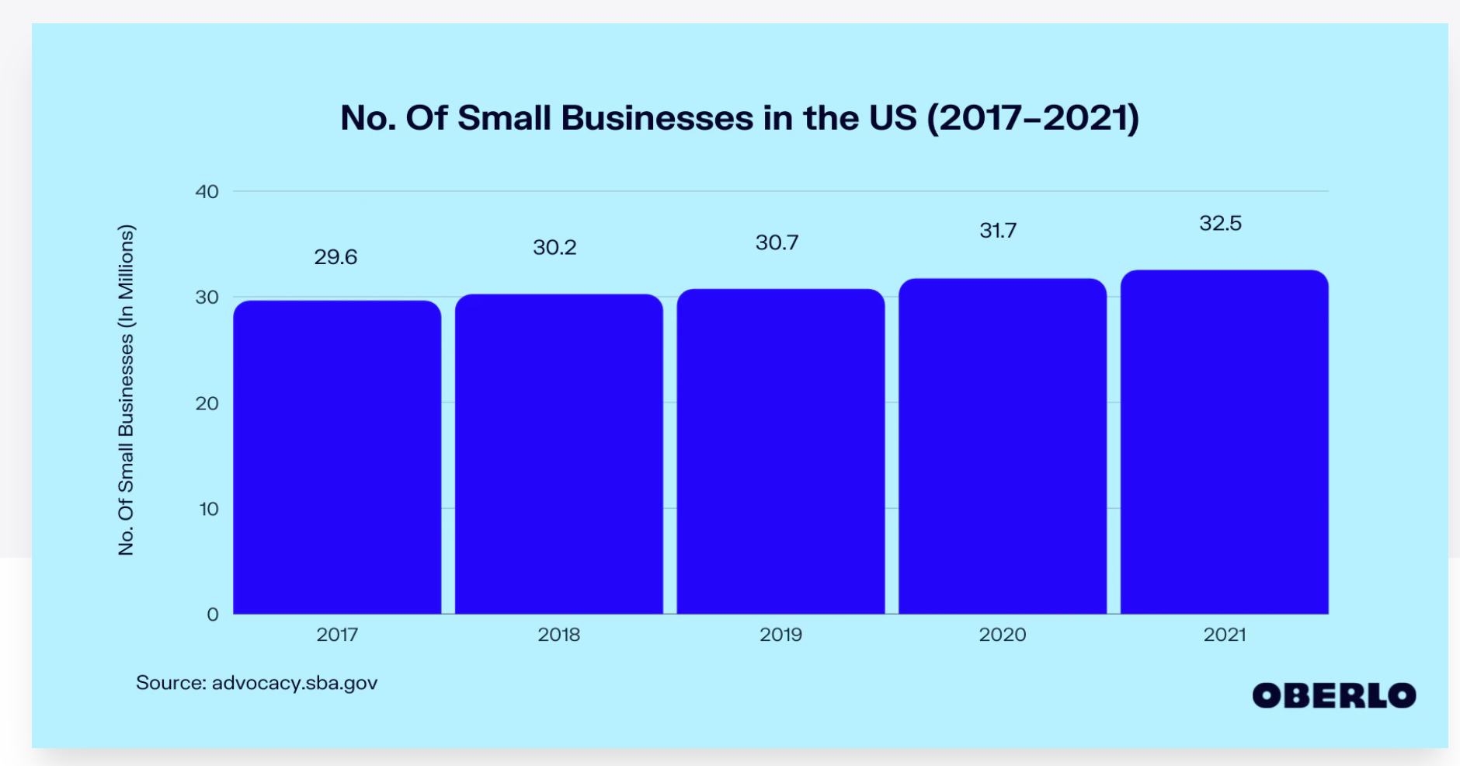
APPENDIX
Small Medium Business Data
Source: (U.S. Small Business Administration, “No. of Small Business in the US”, 2021)
https://www.oberlo.com/statistics/number-of-small-business-in-the-us

Slide 38
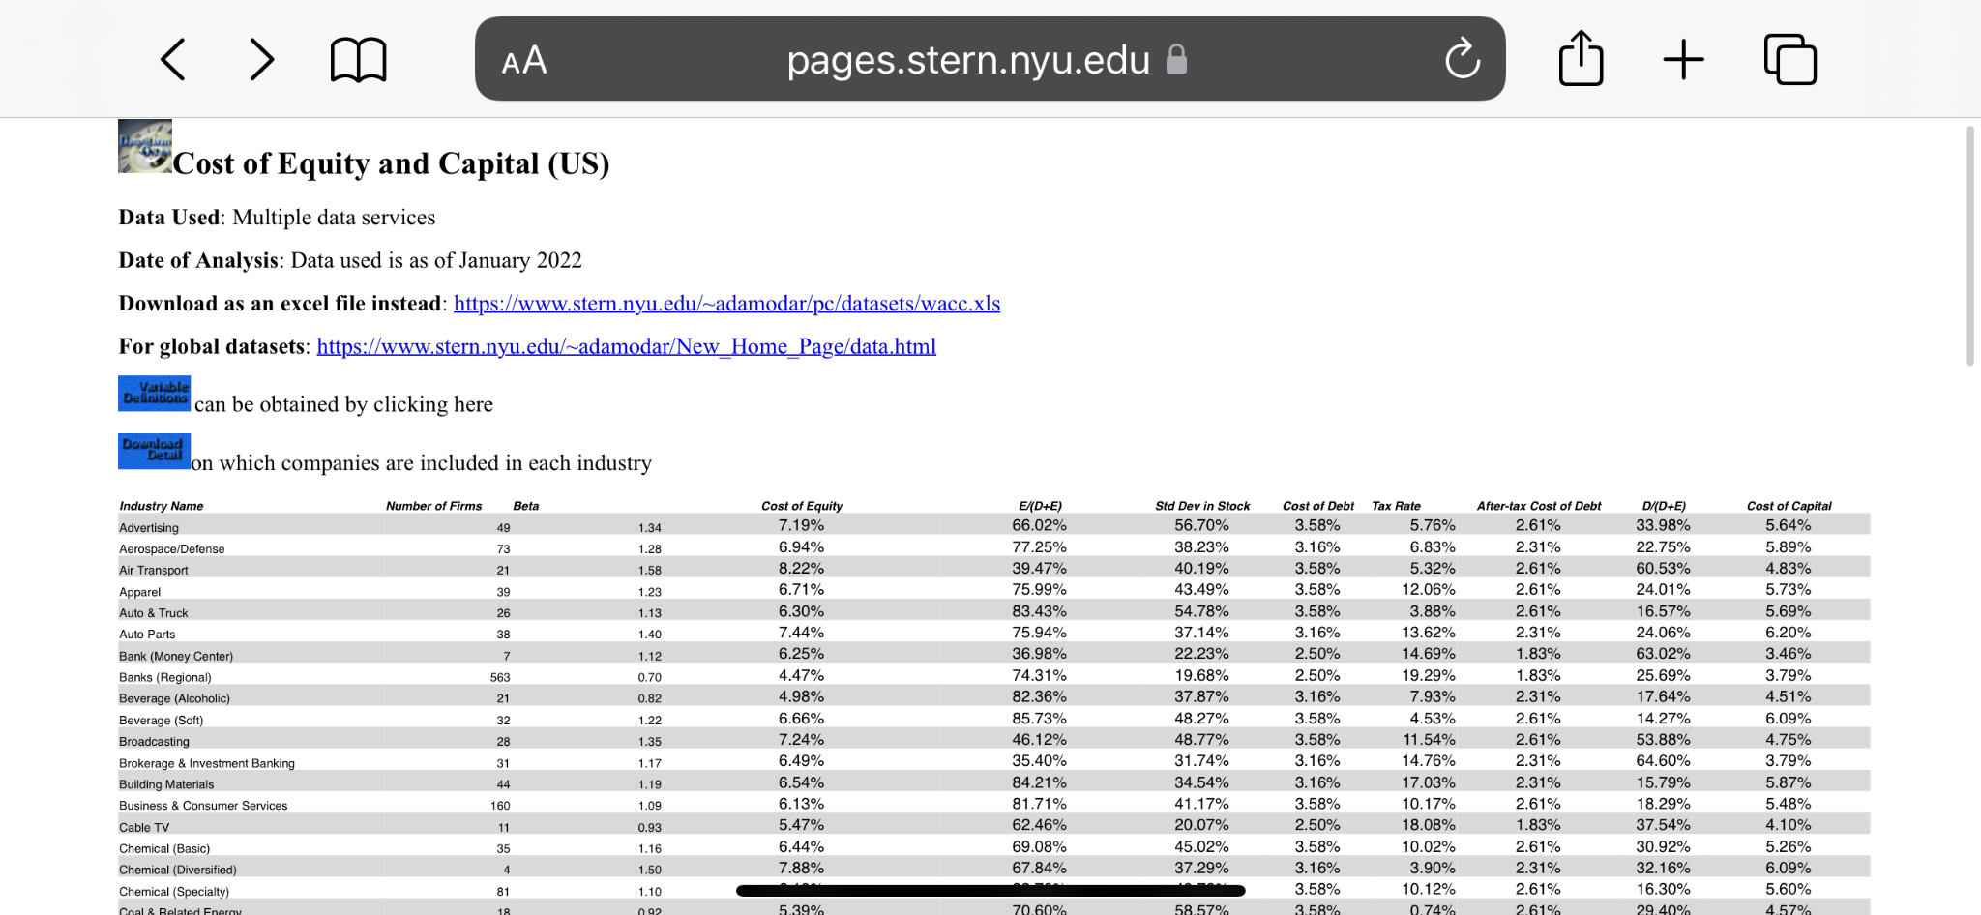
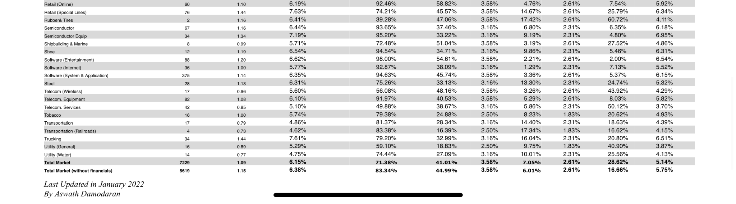
APPENDIX
Discount Rate
Source: (NYU Stern School of Business “Cost of Equity and Capital”, 2022)
https://pages.stern.nyu.edu/~adamodar/New_Home_Page/datafile/wacc.html

Slide 39
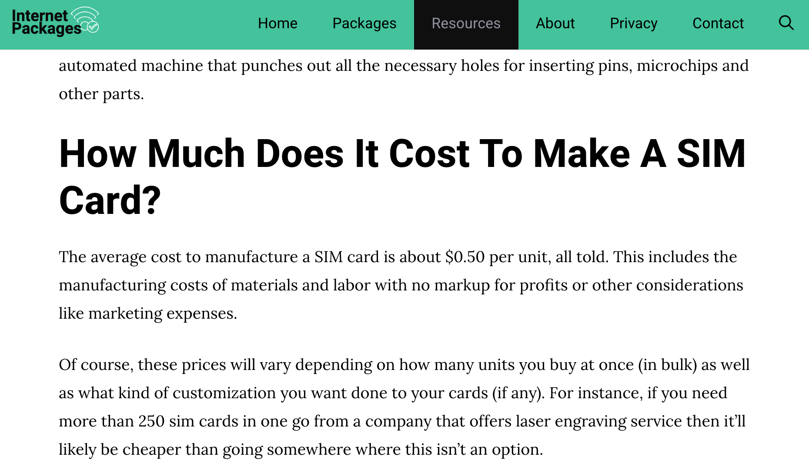
APPENDIX
SIM Card Manufacturing Cost
Source: (Internet Package, “Ave Cost of Manufacturing a SIM Card, 2021)
https://internetpkg.com/average-cost-of-manufacturing-a-sim-card/

Slide 40
APPENDIX
Target Market & Market Penetration
10%
40%
60%
T-Mobile for Business Current Market Share
The objective is to grow the market share to 20% within 5 years.
Market Penetration
Percentage of T-Mobile’s current user in the Market Share that will adapt the 5G for $5 Program

Slide 41
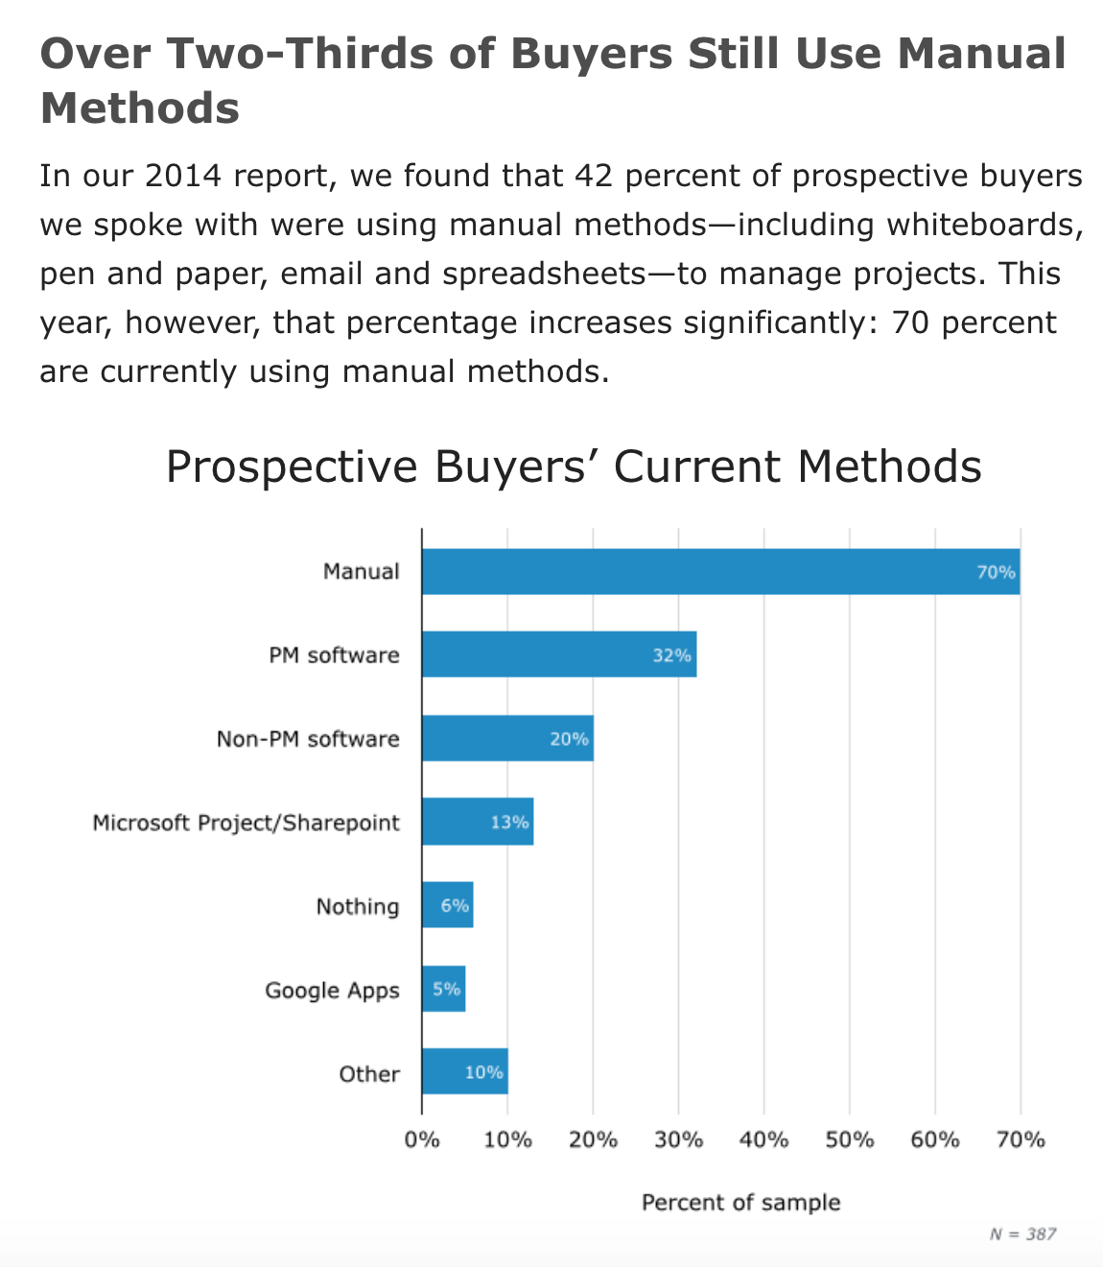
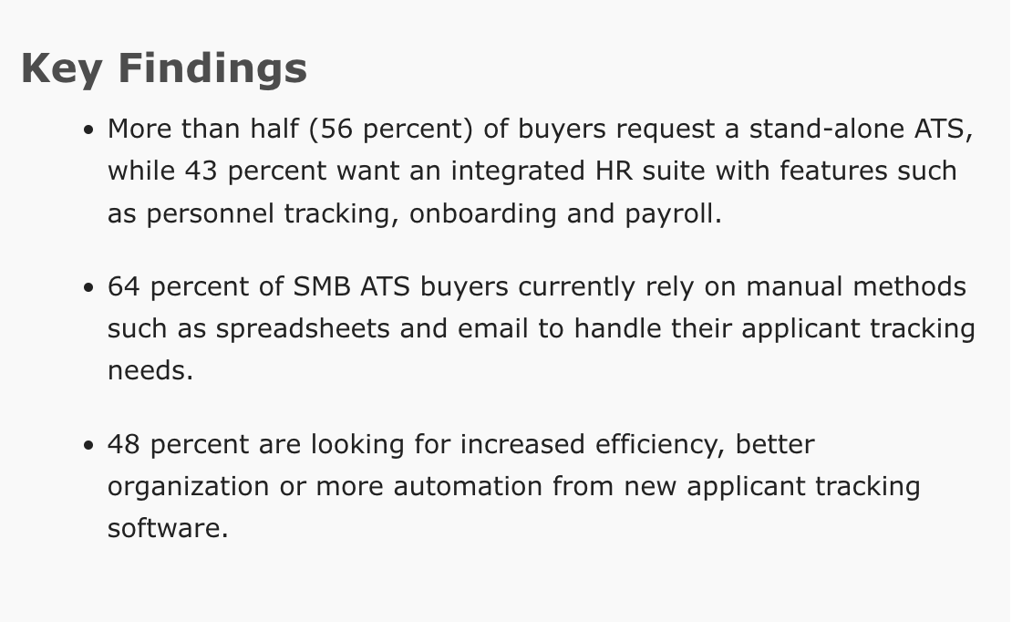
APPENDIX
Target Market Justification
Our target market is small business startups and firms who have not digitalized their operations systems. Research found numerous data that indicates the percentage those target market within SMB population.
Project Management App in 2015
Tracking App Usages in 2016
Source: (Software Advice, “Web Project Management Software SMB Buyer Report – 2015”, 2015)
https://www.softwareadvice.com/resources/web-project-management-buyer-trends-2015/
Source: (Software Advice, “SMB Applicant Tracking System Buyer Report – 2016”, 2016)
https://www.softwareadvice.com/resources/smb-ats-software-trends-2016/

Slide 42
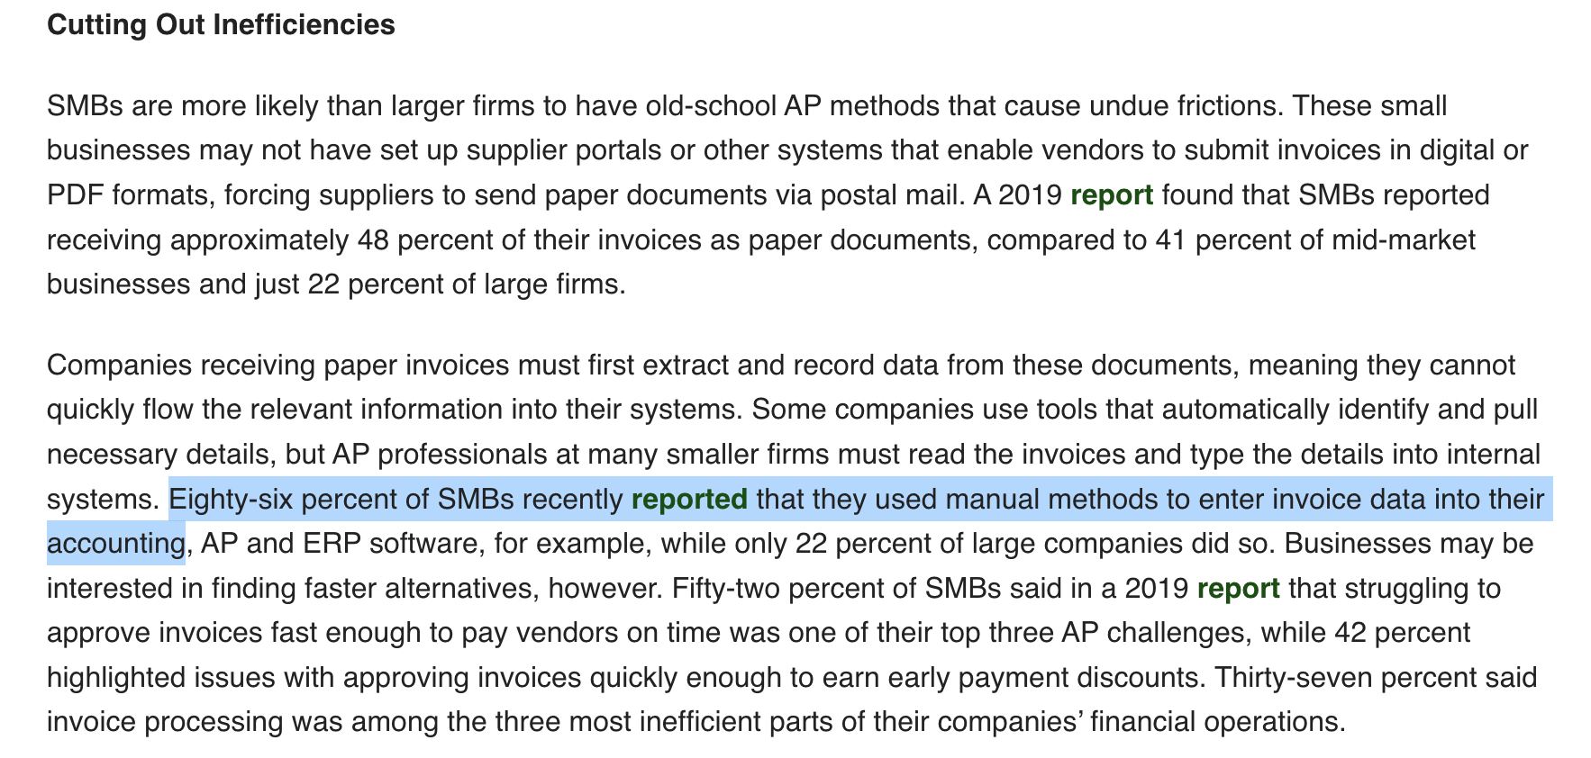
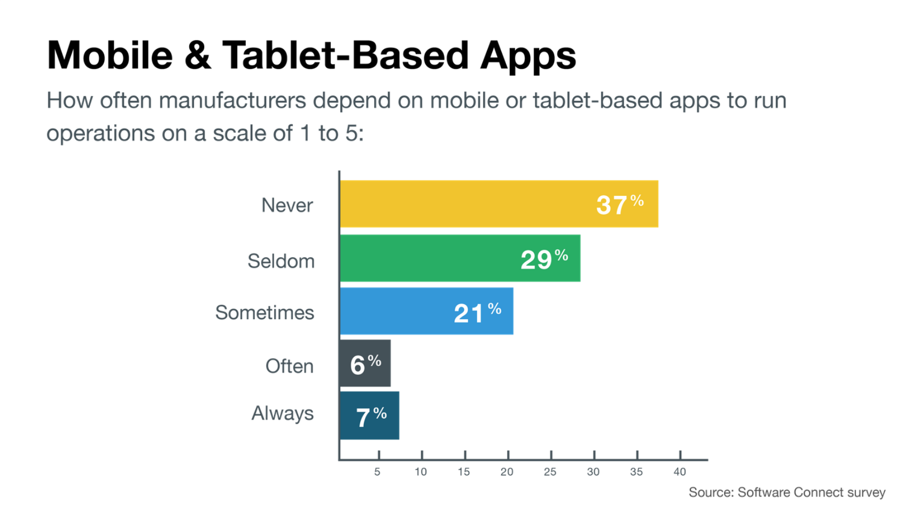
APPENDIX
Target Market Justification
Our target market is small business startups and firms who have not digitalized their operations systems. Research found numerous data that indicates the percentage those target market within SMB population.
Financial App Usages in 2020
Manufacturing Industry Usages of App in 2017
Source: (PYMNTS “Deep Dive: How Utilizing AP Automation Tools Can Help SMBs Endure Financial Strains”, 2020).
https://www.pymnts.com/next-gen-ap-automation/2020/smbs-efficiency-cashflow-payments/
Source: (Software Connect, “Tools of the Modern Manufacturer, 2017 Report”, 2017)
https://softwareconnect.com/manufacturing/tools-of-the-modern-manufacturer-report-2017/

Slide 43
APPENDIX
Financial Analysis - Practical Considerations
No. SMBs in USA : 32.5 M
Discount Rate : 5.10%
Market Penetration : 60%
SMB Market Share : 10%
Subscription Minimum : $45
Internet plan : $5
Baseline Ave #User : 6/biz
Sim Card Mfg Cost : $0.5
In Millions (M)
PROFIT SHARING | 70% | 15% | 15%
Final NPV | $472.72 | $101.30 | $101.30

Slide 44
APPENDIX
Sensitivity Analysis - Project NPV
Back to NPV Analysis

Slide 45
APPENDIX
Sensitivity Analysis - NPV after Profit Sharing
Back to NPV Analysis

Slide 46
APPENDIX
Competitive Positioning
Verizon SWOT
Verizon Data Breach
AT&T SWOT
AT&T SWOT 2
Comcast SWOT

Slide 47
APPENDIX
Retention Rate
Source: (9to5mac, “T-Mobile ranks best in customer retention and growth among major carriers in Q3 — CIRP”, 2018))
https://9to5mac.com/2018/10/22/t-mobile-wireless-customer-retention-growth/

Slide 48
APPENDIX
Implementation Phase Timeline
Phase I:
Research & Development
Market Research
Start: Project Proposal and Outline
App & Software Development
Phase II:
Launch & Campaign
Program Launch
Promotion & Sales Campaign
1st 5G & POS Boot Camp for SMB
POS Onboarding
Phase III:
Service & Maintenance
END: New Technology
Software Update & System Maintenance

